Slide 2
NetDevOps for the Network Dude How to get started with API's, Ansible and Python
François Caen, Systems Engineer Kevin Kuhls, Technical Leader - @sdn_dude
DEVNET- 1002
Notes:
Everyone will have computer with Anyconnect to dcloud instance with IOSXR, IOSXE, IOS, NXOS, ASA devices.
Try out simple ansible core network modules for IOS/IOSXE/IOSXR/NXOS, and asa-api
Clients need
Python, ansible, pycsco, pyiosxr, netmiko from pip
Git pull asa-api,

Slide 3
Agenda
Introduction
Automation Motivation
Tools: Ansible for CLI automation
API’s: better machine communication
Configuration Abstraction
Conclusion

Slide 4

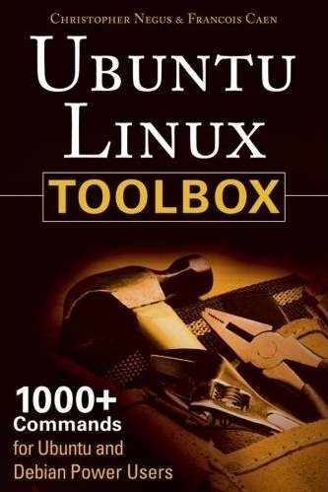
Who are these guys?
…and should I listen or look at my phone?
Kevin Kuhls
1998 – Cisco Router
2002 – PIX Firewall
BIG LULL
2012 – DC Technologies (UCS, Nexus, VMWare)
2014 – OpenStack, ACI
2015 – Network Programmability, SDN
Old Dog learning new tricks
François Caen
1999 – Linux sysadmin
2001 – FLOSS advocate / author
2004 – Network Engineer
2015 – Cisco SE

Slide 5


Motivators for Automation
Cloud-scale:
Lots of Equipment: 1000 Network Devices
Multiple Operating Systems:
IOS, IOSXR, IOSXE, NXOS, ASA OS
Multivendor Security Appliances (WAF, DDoS, LB)
Small team: 6 people
Rapid Deployment
Several new Datacenters per year
Several Service Deployments requiring changes
Enterprise-scale:
Daily repetitive tasks:
New device configuration
3rd party NMS config
Change one config line on all your devices (NF collector,…)
Monitoring:
Be alerted when a route goes away

Slide 6
Automation Requirements
We need an Automation framework that is full of ERRORS
Efficient
Repeatable
Reusable
Observable
Revision controlled
Standard
Notes:
I something that is ...
efficient - it has to save time, not just for fun
repeatable - repeat the process and expect a similar result if there are minor changes or I want to run again and take advantage of idempotency
reusable - the same framework Im using for routers I want to use for switches or even servers
observable - logging and output data to validate and audit
revision controlled - a central repo for code to share and collaborate (git, gerrit, cvs, etc)
standard - I want an industry backed product or tool that is going to be there for a while and that I can leverage a wide range of developers

Slide 7

What is Ansible
Ansible, an open source community project sponsored by Red Hat, is the simplest way to automate IT. Ansible is the only automation language that can be used across entire IT teams – from systems and network administrators to developers and managers.
Ansible by Red Hat provides enterprise-ready solutions to automate your entire application lifecycle – from servers to clouds to containers and everything in between.
It uses no agents and no additional custom security infrastructure, so it's easy to deploy - and most importantly, it uses a very simple language (YAML, in the form of Ansible Playbooks) that allow you to describe your automation jobs in a way that approaches plain English.
Notes:
Got permission from Warren Zweigart <wzweigart@ansible.com>
https://www.ansible.com/logos

Slide 8

Why choose Ansible?
Agentless
Server and support teams already using Ansible
Infrastructure as code
Simple to use and learn
Community and vendor driven
Modular framework, easily modified
Leverage many common programming languages
Notes:
Agentless- we cant load an agent on most network devices
Server team was already on ansible for deployment and
Represented the infrastrucure as code – maintain the yaml and deploy via playbooks
Simple – can spin up users and developers in days or weeks
Community – there are modules for nearly everything you could need
Modular – chop up, add, remove, whatever its all open source
Leverage languages – python, perl, ruby, tcl, bash, whatever the endpoint can execute and return values

Slide 9
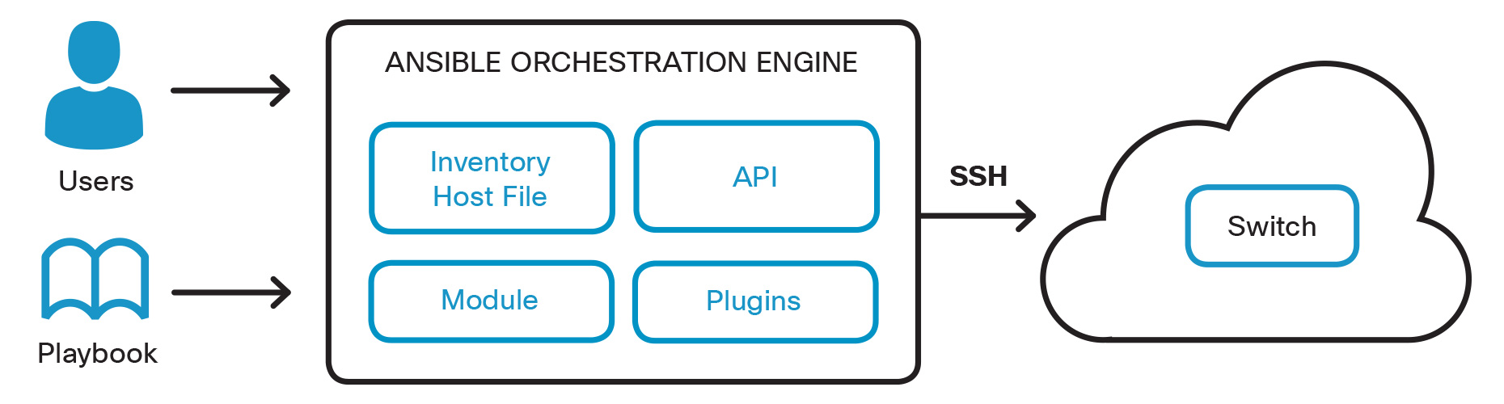
Ansible Configuration Management Workflow
Notes:
Hosts: Remote machines Ansible manages.
Groups: Group of hosts assigned to a pool that can be conveniently targeted and managed together.
Inventory: File describing the Hosts and Groups in Ansible.
Modules: Modules (also referred to as “task plugins” or “library plugins”) are the components that do the actual work in Ansible. They are what gets executed in each playbook task.
Playbooks: A collection of plays which the Ansible Engine orchestrates, configures, administers, or deploys. These playbooks describe the policy to be executed to the host(s). People refer to these playbooks as “design plans” which are designed to be human- readable and are developed in a basic text language called YAML.
Key Technical Concepts
Playbooks
Playbooks specify a list of tasks that are run in sequence across one or more hosts. Each task can also run multiple times with a variable taking a different value. Playbooks are expressed in YAML format.
Inventory
Inventory is the representation of information about hosts — what groups a host belongs to, the properties those groups and hosts have. A hierarchy of groups often results.
Templates
Templates allow you to generate configuration files from values set in various inventory properties. This means that you can store one template in source control that applies to many different environments.
Roles
Roles are a way to encapsulate common tasks and properties for reuse, if you find yourself writing the same tasks in multiple playbooks, turn them into roles.

Slide 10
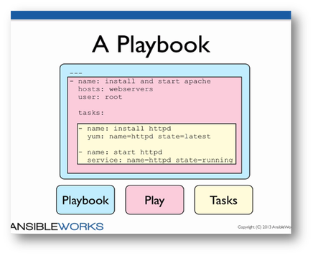
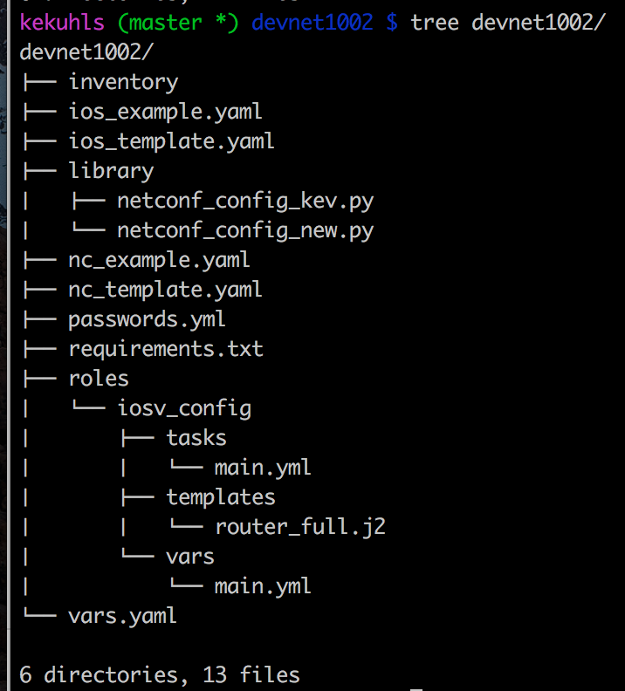
Ansible Terms

Slide 11
Ansible for Networking
- name: load new acl into device
ios_config:
lines:
- 10 permit ip host 1.1.1.1 any log
- 20 permit ip host 2.2.2.2 any log
- 30 permit ip host 3.3.3.3 any log
- 40 permit ip host 4.4.4.4 any log
- 50 permit ip host 5.5.5.5 any log
parents: ip access-list extended test
before: no ip access-list extended test
match: exact
provider: "{{ cli }}"

Slide 12
Jinja Template
Contains variables and/or expressions which get replaced with values when rendered
# Simple Variable Replacment
hostname {{sitecode}}-fw
# Variable Replacement based on Dictionary
route outside 0.0.0.0 0.0.0.0 {{config['vlan101']['ip'][1]}}
# Variable Replacement by Filter
route outside 0.0.0.0 0.0.0.0 {{ external_net_cidr | ipaddr(’1') | ipaddr('address') }}"
# Loop Through set of data to create multiple lines
{%for route in config['routes'] %}
route oob-vpn {{config['routes'][route]['network']}} {{config['routes'][route]['mask']}} {{config['vlan90']['ip'][1]}}
{% endfor %}
# Conditional Statements
{% if config[‘vlan41’] is defined %}
route dmzext {{config['vlan41']['ip'][0]}} {{config['vlan41']['ip'].netmask}} {{config['vlan102']['ip'][1]}}
{endif %}

Slide 13

Yaml
Structure to define:
dictionary (unordered set of key value pairs, lists)
list of items
key value pair
# A sample employee record
name: Francois Caen
job: Systems Engineer
employed: True
languages:
French: Native
English: Fluent
German: Novice
python: Novice
education: Maitrise
favorite foods:
- Currywurst
- Berlinet
Notes:
Likely will skip

Slide 14
Ansible 2.x Exercise
Notes:
Cmd 1-3

Slide 15

Configuration Management Today: CLI
Human Friendly
Task Oriented
Easy To Replay
No Special Tools
Syntax format changes
No Structured output
No Error Reporting
No Transaction
management
Notes:
Cli is great, I love it and I have established a significant relationship with CLI over the past 20 years.
However, it doesn’t fit well in the machine world.
CLI scripting has several limitations including lack of transaction management, no structured error management and ever changing structure and syntax of commands that makes scripts fragile and costly to maintain. These are all side-effects of the basic fact that CLIs are designed to be used by humans and not an API for programmatic access.

Slide 16
Alternatives to CLI automation?

Slide 17

APIs – Application Programming Interfaces
“A set of Function Calls that allow talking to a system”
Programming Building block
APIs can have various Properties
Transport (SSH, HTTP)
Encoding (XML, JSON, ProtoBuffer)
Data structure (Data Models)
Some Examples of APIs
The Twitter API
The Java API
Notes:
So what is the answer – A programmable interface! Built with the machine in mind while not forgetting about the human.
The building blocks of the internet. API’s allow our applicatons to collaborate and become more than the sum of their parts.
Transport, encoding – we can borrow from other successful frameworks.
Models – now that is the cornerstone. We need a model to represent the network device, to describe it configuration and its state.

Slide 18
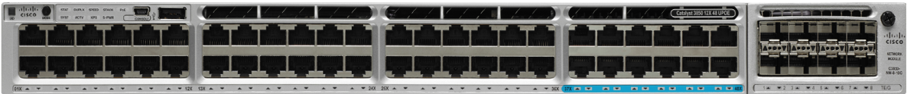
Open Programmable Interface
NETCONF RESTCONF gRPC
NETCONF
RESTconf
gRPC
CLI
Parser
Protocols
Data Model
Models
Device Features
Interface
BGP
QoS
ACL
…

Slide 19



Encoding Formats
“XML, JSON, YAML are Text-file formats used to store structured data for embedded and Web applications”

Slide 20

XML vs JSON vs YAML
{
"ietf-interfaces:interfaces": {
"interface": [
{
"name": "eth0”,
"type": "ethernetCsmacd”,
"location": "0”,
"enabled": true,
"if-index": 2
}
]
}
}
<interfaces xmlns:=“[…]yang:ietf-interfaces”>
<interface>
<name>eth0</name>
<type>ethernetCsmacd</type>
<location>0</location>
<enabled>true</enabled>
<if-index>2</if-index>
</interface>
</interfaces>
---
ietf-interfaces:interfaces:
interface:
name: eth0
type: ethernetCsmacd
location: 0
enabled: true
if-index: 2
Notes:
Lets just quickly compare how they look,
You can see the key/value logic is the same, just represented slighly different
XML is a file extension for an Extensible Markup Language (XML) file format used to create common information formats and share both the format and the data on the World Wide Web, intranets, and elsewhere using standard ASCII text. XML is similar to HTML.
Yaml is also readable and compact, its usually consumed directly by some programming language

Slide 21
NETCONF definition
“NETCONF is a protocol defined by the IETF to install, manipulate, and delete the configuration of network devices”
V 1.0
V 1.1
Extensions
RFC 4741 1.0 Base NETCONF Protocol
RFC 4742 NETCONF over SSH
RFC 6241 – 1.1 Base NETCONF Protocol
RFC 6242 – NETCONF over SSH
RFC 5277 Notifications
RFC 5717 Partial Locking
RFC 6243 With defaults
RFC 6020 YANG
2006
2011

Slide 22
NETCONF Operations
Main Operations | Description
<get> (close to ‘show ?’) | Retrieve running configuration and device state information
<get-config> (close to ‘show run’) | Retrieve all or part of specified configuration datastore
<edit-config> (close to ‘conf t’) | Loads all or part of a configuration to the specified configuration datastore
Other Operations | Description
<copy-config> | Replace an entire configuration datastore with another
<delete-config> | Delete a configuration datastore
<commit> | Copy candidate datastore to running datastore (ex: XR)
<lock> / <unlock> | Lock or unlock the entire configuration datastore system
<close-session> | Graceful termination of NETCONF session
<kill-session> | Forced termination of NETCONF session
Notes:
Here are the operations you can perform via netconf, very similar to http transactions
you can filter the requests to get a subset of the data
What do you want to do if you do configuration automation
retrieve config
edit config
might want to copy from one place to another
if os supports it, have the ability to do commit (IOS XR)
being able to lock and unlock config so that others can’t make changes while you are
can also get operational state
can get some state through netconf
fairly sophisticated - not simple crud read/write
this is not a complete list
Netconf also takes into account the notion of different data stores
runnign config
startup config
ftp / from a url

Slide 23
<get-config>
<rpc message-id="101" xmlns="urn:ietf:params:xml:ns:netconf:base:1.0">
<get-config>
<source>
<running/>
</source>
<filter>
<interfaces xmlns="urn:ietf:params:xml:ns:yang:ietf-interfaces">
<interface>
<name>GigabitEthernet0</name>
</interface>
</interfaces>
</filter>
</get-config>
</rpc>
Notes:
Here is a specific get-config message to the box – you can see we are asking for running-config and filtering on an interface gig 0

Slide 24
<get-config> Response
<rpc-reply message-id="urn:uuid:bdb1189e-4480-11e6-8507-fa163e2846a4" xmlns="urn:ietf:params:xml:ns:netconf:base:1.0" xmlns:nc="urn:ietf:params:xml:ns:netconf:base:1.0">
<data>
<interfaces xmlns="urn:ietf:params:xml:ns:yang:ietf-interfaces">
<interface>
<name>GigabitEthernet0</name>
<type xmlns:ianaift="urn:ietf:params:xml:ns:yang:iana-if-type">ianaift:ethernetCsmacd</type>
<enabled>true</enabled>
<ipv4 xmlns="urn:ietf:params:xml:ns:yang:ietf-ip">
<address>
<ip>172.26.170.253</ip>
<netmask>255.255.254.0</netmask>
</address>
</ipv4>
<ipv6 xmlns="urn:ietf:params:xml:ns:yang:ietf-ip"/>
</interface>
</interfaces>
</data>
</rpc-reply>
Notes:
And here is the response as received, but take a close look, do you know the cli counterpart?...
Show run int
Also notice the payload between this slide and the next edit-config?

Slide 25
<edit-config>
<rpc message-id="101" xmlns="urn:ietf:params:xml:ns:netconf:base:1.0">
<edit-config>
<target>
<running/>
</target>
<config>
<interfaces xmlns="urn:ietf:params:xml:ns:yang:ietf-interfaces">
<interface>
<name>GigabitEthernet0/0/0</name>
<ipv4 xmlns="urn:ietf:params:xml:ns:yang:ietf-ip">
<address>
<ip>1.1.1.1</ip>
<netmask>255.255.255.255</netmask>
</address>
</ipv4>
</interface>
</interfaces>
</config>
</edit-config>
</rpc>
Notes:
Your get-config is the framework to edit your config
Easy SW interface

Slide 26
<edit-config> Response
<rpc-reply message-id="urn:uuid:d5fa0c22-4484-11e6-9132-fa163e2846a4" xmlns="urn:ietf:params:xml:ns:netconf:base:1.0" xmlns:nc="urn:ietf:params:xml:ns:netconf:base:1.0">
<ok/>
</rpc-reply>
Notes:
There is no grey area on whether the command was received

Slide 27
<edit-config> Rollback
<rpc message-id="101" xmlns="urn:ietf:params:xml:ns:netconf:base:1.0">
<edit-config>
<target>
<running/>
</target>
<config>
<interfaces xmlns="urn:ietf:params:xml:ns:yang:ietf-interfaces">
<interface>
<name>GigabitEthernet0/0/0</name>
<description>DID-ROLLBACK-WORK</description>
<ipv4 xmlns="urn:ietf:params:xml:ns:yang:ietf-ip">
<address>
<ip>blah</ip>
<netmask>255.255.255.255</netmask>
</address>
</ipv4>
</interface>
</interfaces>
</config>
</edit-config>
</rpc>
Notes:
Bad data in edit rolls back the whole transaction
Notice the description was changed as well, however the transations are all or none. In this case no changes in the transaction will apply
How would a Cli any error in the middle of the script react? Not good, gives unknown outcome

Slide 28
<edit-config> Rollback Response
<error-info xmlns="urn:ietf:params:xml:ns:netconf:base:1.0" xmlns:nc="urn:ietf:params:xml:ns:netconf:base:1.0">
<bad-element>ip</bad-element>
</error-info>
Notes:
And here is the response of our failed edit
the entire transaction is nullified.

Slide 29
Ansible for Networking
- name: configure new ntp server
netconf_config:
xml: |
<config xmlns:xc="urn:ietf:params:xml:ns:netconf:base:1.0">
<system xmlns="urn:ietf:params:xml:ns:yang:ietf-system">
<ntp>
<enabled>true</enabled>
<server>
<name>ntp1</name>
<udp><address>127.0.0.1</address></udp>
</server>
</ntp>
</system>
</config>

Slide 30
NETCONF Exercise
Notes:
Cmd 4-5

Slide 31

Three Things to Like about NETCONF
Capability discovery, model download
Transactions
Notifications
Notes:
Easy capability discovery as part of the initial handshake with the device, you can even download the models the device supports to take a sloce look at your options
Transations – all or nothing. There is also a concept of confirmed commmit where even save a properly formatted bad config change will rollback without a confirmed commit message
Notification of success of intent

Slide 32
Configuration Abstraction

Slide 33
Infrastructure as Code Example
Variable structure to represent Campus Fabric
fabric:
- tenant_name: DEVELOPMENT
vrf_id: 103
ints:
- vlan_id: 3240
name: "10_103_240_0-DATA"
subnet: " 10.103.240.0/24"
- tenant_name: EMPLOYEE
vrf_id: 101
ints:
- vlan_id: 1240
name: "10_101_240_0-DATA"
subnet: " 10.103.240.0/24”
- vlan_id: 1241
name: "10_101_241_0-VOICE"
subnet: " 10.101.241.0/24”
Notes:
Representing Networking configuration as a set of structured variables. YAML above.
This is fully abstracted variable skeleton. How it gets pushed no longer matters.

Slide 34
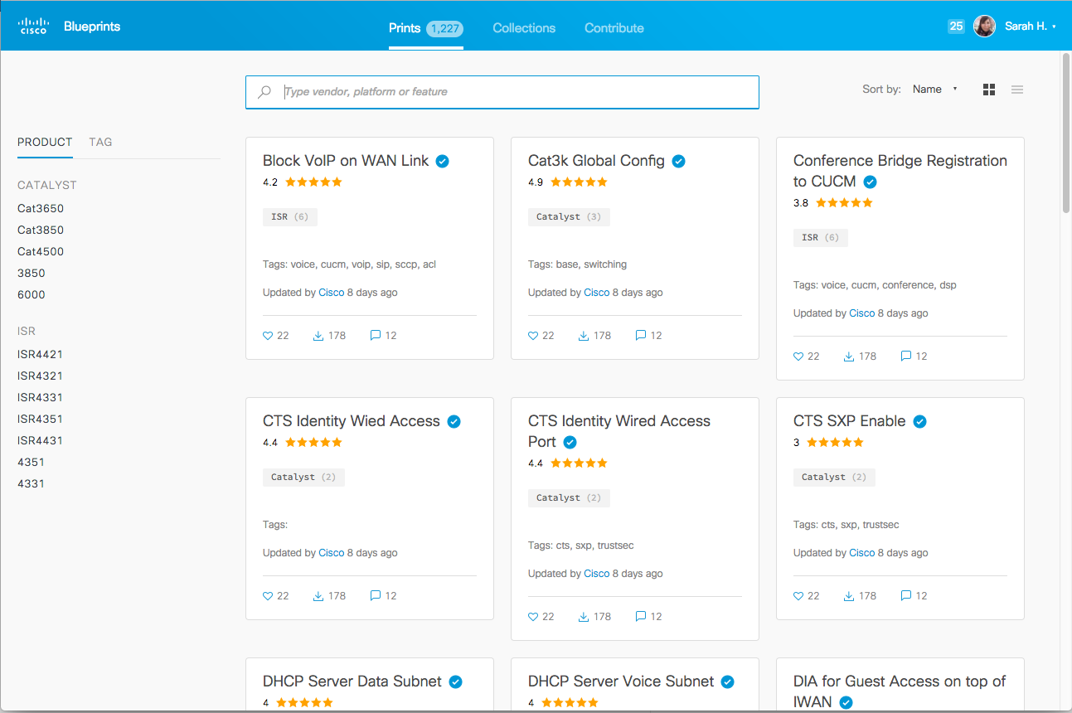
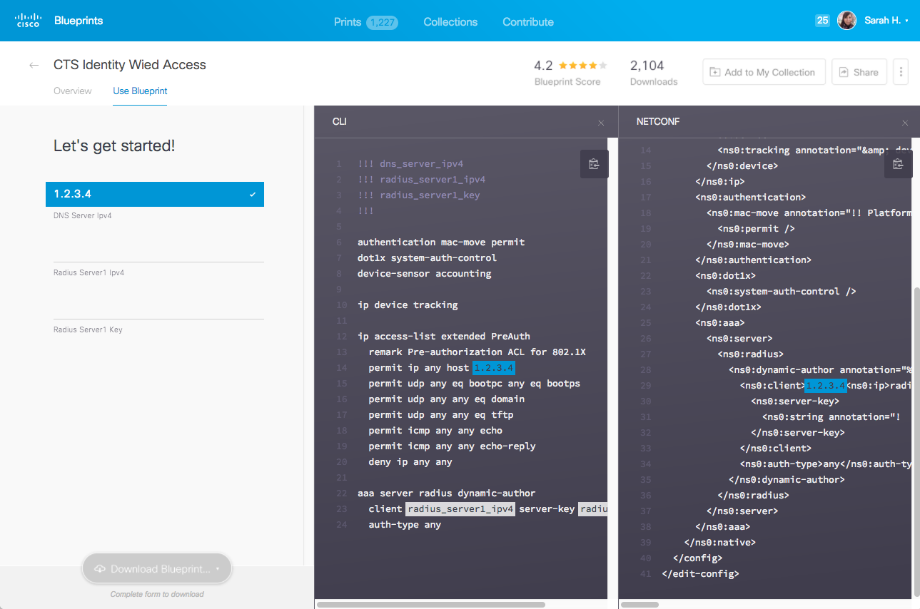
Cisco Configuration Blueprints

Slide 35
Cisco Configuration Repository Exercise

Slide 36
References
Ansible – http://www.Ansible.com
Jinja - https://kontrolissues.net/2016/01/14/intro-to-jinja2/
YAML - http://www.yaml.org/start.html
VIRL – Virtual Internet Routing Lab (how the demos were deployed) http://virl.cisco.com/
dCloud – The Cisco Demo Cloud (where the demos were deployed) https://dcloud.cisco.com/
(ask your Cisco account team or partner for access)
Source code in Github:
Clone exercises from session: git clone git@github.com:kuhlskev/devnet1002.git
Ansible Networking - https://github.com/ansible/ansible-modules-core/tree/stable-2.1/network
Napalm - https://github.com/napalm-automation/napalm
Cisco Config Repo
Blogs:
https://pynet.twb-tech.com/
http://jedelman.com
https://networklore.com/

Slide 38
Continue Your Education
Demos in the Cisco campus
Walk-in Self-Paced Labs
Lunch & Learn
Meet the Engineer 1:1 meetings
Related sessions

Slide 39

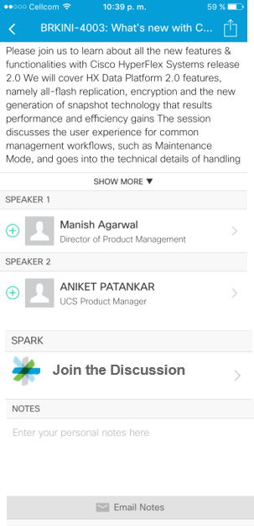

Cisco Spark Ask Questions, Get Answers, Continue the Experience
Use Cisco Spark to communicate with the Speaker and fellow participants after the session
Download the Cisco Spark app from iTunes or Google Play
Go to the Cisco Live Berlin 2017 Mobile app
Find this session
Click the Spark button under Speakers in the session description
Enter the room, room name = DEVNET-1002
Join the conversation!
The Spark Room will be open for 2 weeks after Cisco Live

Slide 40
Q & A

Slide 43
Building the Environment
This is a rough guideline how to bring up / prepare the entire environment.
Git client
VirtualBox 5.0.28
Vagrant 1.8.7 (be aware of this issue)
cdrtools (in particular mkisofs)
a build environment (e.g. compiler, make, ...), suggest to use MacPorts or Brew if running on a Mac
Clone the iso-xrv-x64-vbox repository from GitHub
IOS XE image from Cisco.com (e.g. here, then go to IOS XE Software and download the Denali-16.3.2 .iso file in the Latest tree branch, ~350MB in size)
DEVNET-2449

Slide 44
Building the Environment (cont)
Building the Vagrant Box
Go to the directory where you cloned the iso-xrv-x64-vbox repository. Start the Vagrant box image build by running the following command
iosxe_iso2vbox.py -v ~/Downloads/csr1000v-universalk9.16.03.02.iso
This will take a while. When done, you need to install the resulting box into Vagrant:
vagrant box add --name iosxe csr1000v-universalk9.16.03.02.box
(See the output at the end of the script. It has the exact location of the generated box file and also the command to add / replace the Vagrant box file).
DEVNET-2449

Slide 45
Configure and Start Routers
The next steps are required to prepare configuration disks for the routers
Clone this repo from GitHub into a new directory: https://github.com/kuhlskev/devnet1002
Make sure that the Vagrant box name matches the one configured in the Vagrant file
Ensure you have the required tools installed
run make to create the ISO files with the router configurations
Bring up the routers using vagrant up (brings up both) or vagrant up rtr1 to only start rtr1
DEVNET-2449

Slide 46
Protocols
NETCONF
RESTconf
gRPC
Standard | IETF RFC 6241 | IETF draft | Open source
Optimized for Networking | ✓ | ✓ | ✗ (designed for generic client/server communications)
Session Oriented | ✓ | ✓ | ✓
Connection Oriented | ✓ | ✗ | ✓
Connection Security | SSH or SOAP | HTTPS | HTTPS
Notes:
Transport options to get yang from a to b
But before we dive into the details on the protocols we need to take a quick detour to the encoding formats they use

Slide 47



REST (REpresentational State Transfer)
RESTful
GET |PUT | POST | DELETE
“A framework for client-server communications”
not a standard
Architectural constraints
Client–server
Stateless
Cacheable
Layered system
Uniform interface
GET
POST
API
PUT
DELETE
Notes:
Is an API construct to present a http like interface with familiar operation verbs like get/post/put/delete
Intentionally stateless with a focus on state transfer, from state a to state b, Like netconf - no issues with command sequencing or order operations

